Slide 11
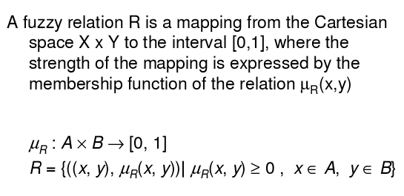
FUZZY RELATION
Computer Science and Engineering, VJCET, Vazhakulam

Slide 12
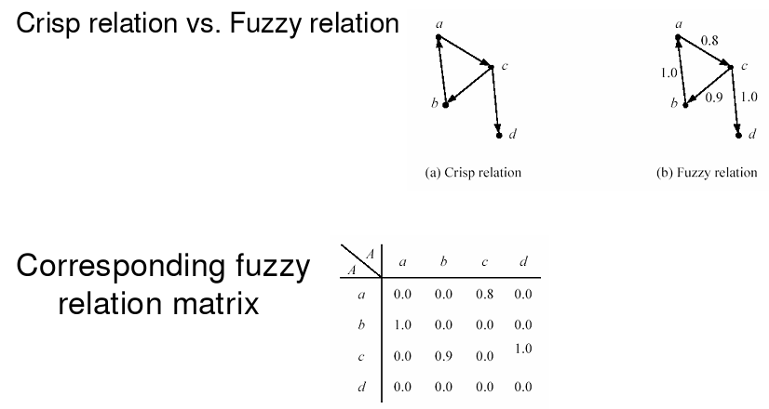
Computer Science and Engineering, VJCET, Vazhakulam

Slide 13

OPERATIONS ON FUZZY RELATION
The basic operation on fuzzy sets also apply on fuzzy relations.
Computer Science and Engineering, VJCET, Vazhakulam

Slide 14
Computer Science and Engineering, VJCET, Vazhakulam

Slide 15
PROPERTIES OF FUZZY RELATIONS
The properties of fuzzy sets (given below) hold good for fuzzy relations as well.
        Commutativity,
        Associativity,
        Distributivity,
        Involution,
        Idempotency,
        DeMorgan’s Law,
        Excluded Middle Laws.
Computer Science and Engineering, VJCET, Vazhakulam

Slide 16
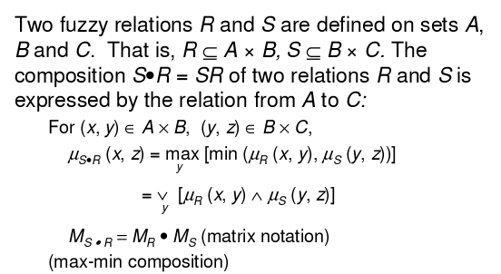
COMPOSITION OF FUZZY RELATIONS
Computer Science and Engineering, VJCET, Vazhakulam

Slide 17
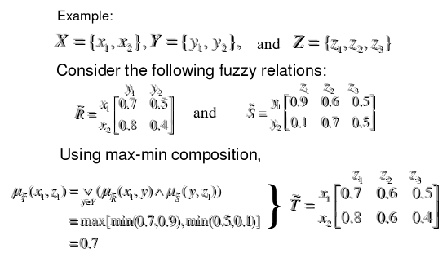
Computer Science and Engineering, VJCET, Vazhakulam

Slide 18
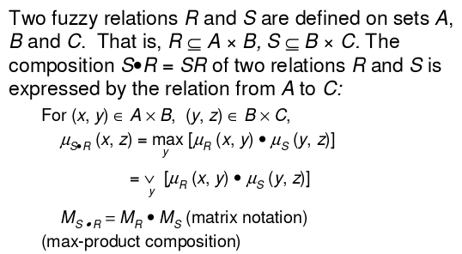
Computer Science and Engineering, VJCET, Vazhakulam

Slide 19
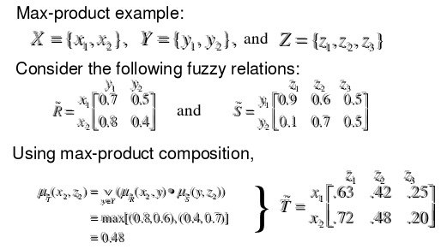
Computer Science and Engineering, VJCET, Vazhakulam

Slide 20
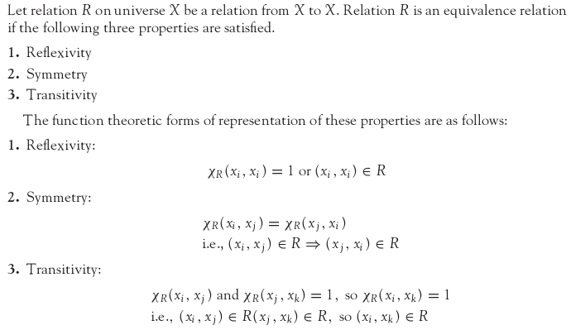
CLASSICAL EQUIVALENCE RELATION
Computer Science and Engineering, VJCET, Vazhakulam

Slide 21
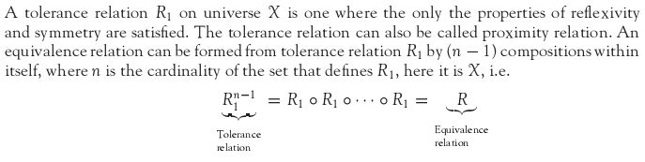
CLASSICAL TOLERANCE RELATION
Computer Science and Engineering, VJCET, Vazhakulam

Slide 22
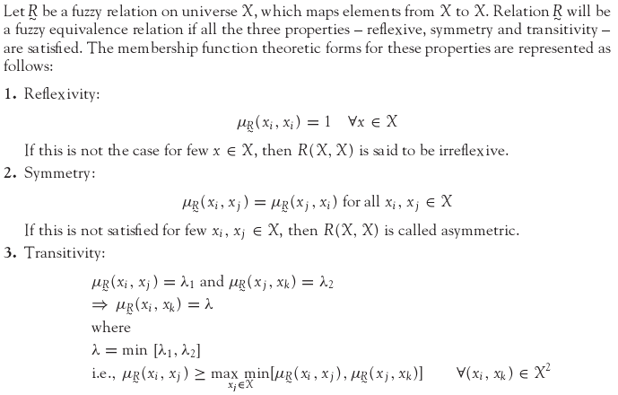
FUZZY EQUIVALENCE RELATION
Computer Science and Engineering, VJCET, Vazhakulam

Slide 23

FUZZY TOLERANCE RELATION
A binary fuzzy relation that possesses the properties of reflexivity and symmetry is called fuzzy tolerance relation or resemblance relation.
The equivalence relations are a special case of the tolerance relation. The fuzzy tolerance relation can be reformed into fuzzy equivalence relation in the same way as a crisp tolerance relation is reformed into crisp equivalence relation, i.e.,
where ‘n’ is the cardinality of the set that defines R1.
Computer Science and Engineering, VJCET, Vazhakulam

Slide 24
SUMMARY
The chapter provides the definition, properties, and operations of the following:
Classical sets,
Fuzzy sets,
Classical relations,
Fuzzy relations.
The chapter also discusses crisp and fuzzy equivalence and tolerance relations.
Computer Science and Engineering, VJCET, Vazhakulam

